Slide 1



Robotic Arm Control via Hand
Gestures
By Willem Hueffed

Slide 2

Imagine A
World Where
Robots are part of our daily life
We could give them verbal instructions
What about people who are speech imparied?

Slide 3

Project Overview
Hand Gesture Control
Camera Input
The robot needs eyes
Sign Language for Robots
Gesture Classifier
The Robotic Arm
The vocabulary of the robot
Its what gets stuff done!

Slide 4

Dependencies
Packages
Software
Hardware
Ubuntu 20.04 LTS
ROS2 Galactic
Git + GitHub
Python 3
C++
Locobot WX250s
Intel D435 RGBD
RealSense SDK
MediaPipe
Trossen ROS2 Packages

Slide 5
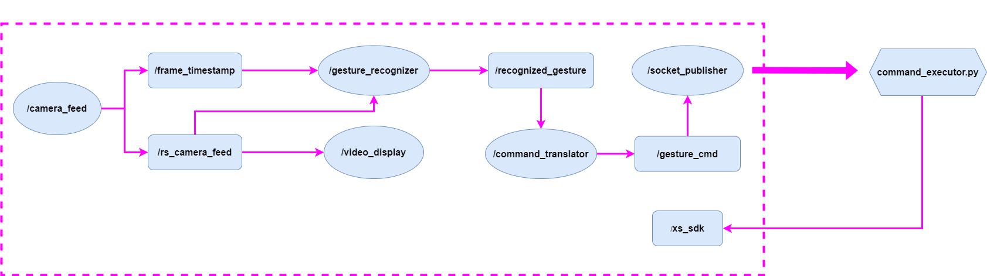
Software Architecture

Slide 6
Nodes & Scripts
/camera_feed
/video_display
/socket_publisher
Wraps the RealSense Camera SDK
Displays Video Via OpenCV
Pose Command -> Python API via Socket
/gesture_recognizer
/command_translator
command_executor.py
Hand Gesture Recognition
Gesture -> Pose Command
Runs Trossen Python API
/xs_sdk
Trossen’s Servo Control

Slide 7


Slide 8
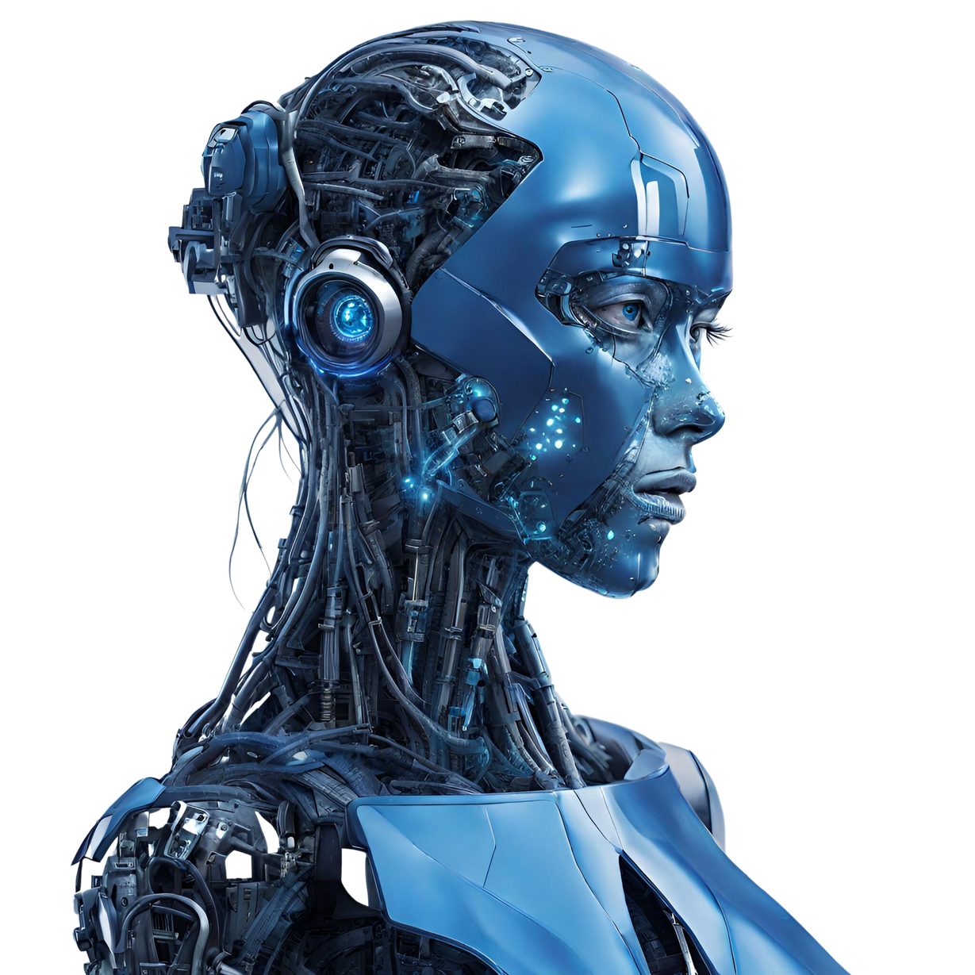
Challenges
Networking
Mobile Hotspot
MoveIt Interface
I’m still confused
Trossen’s Python API
Bugged
Runtime Error

Slide 9

Lessons Learned
Grit
Persistance
Dealing with Hardware

Slide 10


Future Work
Render Landmarks
MP Drawing Tools
Display EE Coordinates
Tkinter?
Extend The Model
Add More Gestures
Extend Arm control
Add Base Rotation

Slide 11


Advice For Past Me
Take a Deep Breath
Set It Down
Sucsess is
Cyclical
Highs & Lows
Don‘t Be Afraid to Pivot
TurtleSim
Document
Everything
Commit History Isn’t Enough

Slide 12



Recap
Gesture Control
Of Robot
Implications for Human Robot Interaction
Relative Sucsess Given Challenges

Slide 13


Thank You!
whueffed@seattleu.edu
https://github.com/WillemHueffed/SU_Robotics

